Slide 1
3a. Filaricele Surgery Training Presentation Section A
This presentation is one component of a larger resource package titled Filaricele Surgery Training Package.
The presenter/facilitator should read and be familiar with the other components of the resource package before delivering this presentation – particularly 2. Facilitator’s Guide for Filaricele Surgery Training.
To effectively deliver this content, the presenter/facilitator must have technical knowledge of hydrocele surgery, equivalent to that of a technical supervisor or national trainer.

Slide 2
TRAINING ON FILARICELE SURGERY
Section A

Slide 3
Session 1: Introductions

Slide 4
Session 2: Introduction to Lymphatic Filariasis and Filaricele Surgery

Slide 5
Lymphatic Filariasis

Slide 6
Lymphatic Filariasis Overview Questions
What are the two aspects of elimination of LF as a public health problem?
What drugs are distributed during mass drug administration for LF?
How many men worldwide suffer from hydrocele?
What are two different surgical approaches for hydrocele?
How many men are estimated to have hydrocele in your country?

Slide 7
Video: Lymphatic Filariasis Overview

Slide 8
Video: Life Cycle of Wucheria Bancrofti

Slide 9
Session 3: Overview of Lymphatic Filariasis In [Country Name]

Slide 10
Overview of LF in [Country Name]
Presentation by [insert name of national LF program and/or presenter]
[DISPLAY SEPARATE PRESENTATION FROM THE REPRESENTATIVE OF THE NATIONAL LF PROGRAM]

Slide 11
Session 4: Introduction to Filaricele Surgery Training Package

Slide 12
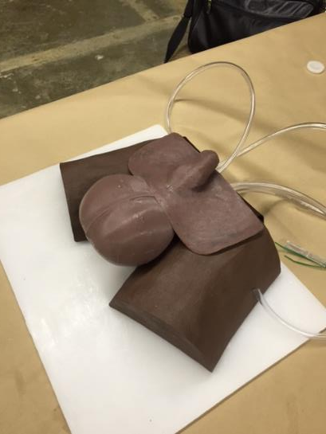
Filaricele Surgery Training Package
Theoretical Sessions:
Presentations
Video clips
Discussions
Practical sessions:
Observation of live surgery
Supervised surgery on live patients
FASTT: Filaricele Anatomical Surgical Task Trainer (optional)

Slide 13
Video: Introduction to Training Package
Notes:
DEFINE FILARICELE: hydrocele caused by lymphatic filariasis. This is the preferred terminology used to distinguish it from other types of hydroceles.

Slide 14
Session 5: Targeting Safe Surgery and High-Quality Results

Slide 15
WHO Filaricele Surgery Indicators
Input Indicators
Total number of patients with hydrocele
Total number of hydrocele patients who were treated
Process indicators
Number of health workers trained
Number of health facilities with a surgeon or medical doctor trained in hydrocelectomy
Outcome Indicators
Number of patients with infection within 5 days of surgery
Number of patients with hematoma within 5 days of surgery
Number of patients who had recurrence of hydrocele after surgery
Impact Indicator
Reduction in number of patients with hydrocele who were treated
Notes:
These indicators are based on WHO recommendations made in the guide for project managers.
These indicators may be tracked through national and international reporting systems, such as through the WHO Surgical Assessment Tool.
They are important for completing the LF elimination dossier.

Slide 16
Safe Surgery and High-Quality Results
Data collection guides program planning and evaluation.
The WHO recommended indicators capture surgical care provision at all levels of the health system and they track surgical outcomes among patients.
These quality assurance measures can identify areas of weakness or concern that can be addressed through training.

Slide 17
Session 6: Anatomy of the Male Reproductive System

Slide 18
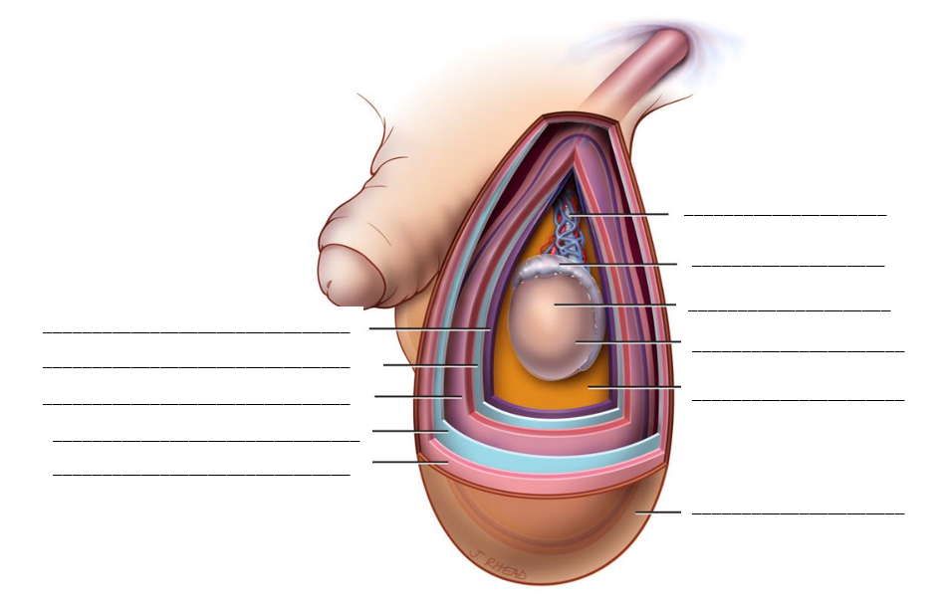
Anatomy of the Male Reproductive System
Source: Surgical approaches to the urogenital manifestations of lymphatic filariasis. Report from an informal consultation among experts, World Health Organization; 2019
Notes:
Vessels: The anterior (skin) wall of the scrotum is supplied by the external pudendal vessels. They do not cross the raphe. The posterior (skin) wall of the scrotum is supplied by the posterior scrotal branches of the perineal arteries. The spermatic fascia and cremasteric blood supply have their own (separate) vessels--different from the skin. The vas and testicle each have their own arterial supply but there are collaterals from the cremasteric vessels and from each other.
The testicular veins form a pampiniform plexus that converge to a single external spermatic vein at approximately the internal ring. Dilation of the plexus can appear as a varicocele, that can be confused with dilated lymphatics in LF.
Lymphatics: The scrotal lymphatics do not cross the median raphe. The lymphatics of all layers of the scrotum drain to the inguinal lymph nodes (deep and superficial) whereas the lymphatics of the testicle and epididymis drain along the retroperitoneal path of the testicular veins and deep pelvic nodes
“Ductus deferens” is more commonly known as the vas deferens and is referred to as the “vas deferens” or the “vas” in later videos. If “ductus deferens” is used in Video #3, it should also be acknowledged as the vas deferens.

Slide 19
Video: Anatomy of the Male Reproductive System

Slide 20
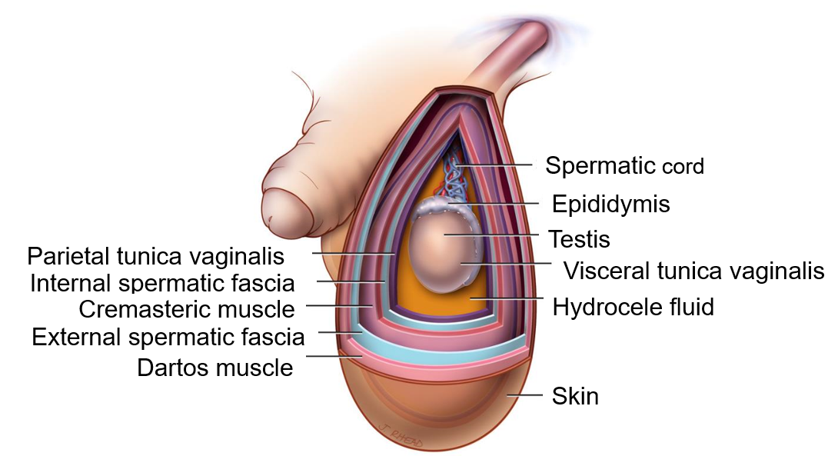
Anatomy of the Male Reproductive System
Source: Surgical approaches to the urogenital manifestations of lymphatic filariasis. Report from an informal consultation among experts, World Health Organization; 2019
Notes:
Vessels: The anterior (skin) wall of the scrotum is supplied by the external pudendal vessels. They do not cross the raphe. The posterior (skin) wall of the scrotum is supplied by the posterior scrotal branches of the perineal arteries. The spermatic fascia and cremasteric blood supply have their own (separate) vessels--different from the skin. The vas and testicle each have their own arterial supply but there are collaterals from the cremasteric vessels and from each other.
The testicular veins form a pampiniform plexus that converge to a single external spermatic vein at approximately the internal ring. Dilation of the plexus can appear as a varicocele, that can be confused with dilated lymphatics in LF.
Lymphatics: The scrotal lymphatics do not cross the median raphe. The lymphatics of all layers of the scrotum drain to the inguinal lymph nodes (deep and superficial) whereas the lymphatics of the testicle and epididymis drain along the retroperitoneal path of the testicular veins and deep pelvic nodes
“Ductus deferens” is more commonly known as the vas deferens and is referred to as the “vas deferens” or the “vas” in later videos. If “ductus deferens” is used in Video #3, it should also be acknowledges as the vas deferens.

Slide 21
Session 7: Staging and Grading of Hydrocele

Slide 22
Staging and Grading of Hydrocele
Type of Hydrocele | Single | Bilateral
Side of Hydrocele | Right | Left
Stage of Hydrocele | I | Less than a tennis ball (~160ml)
 | II | Larger than stage 1. Lower pole does not extend below mid-thigh.
 | III | Lower pole extends below mid-thigh but not below upper-edge of the patella
 | IV | Lower pole extends below patella and not below the tibial tuberosity
 | V | Lower pole extends below tibial tuberosity but not below mid leg
 | VI | Lower pole extends below mid leg
Grade of Hydrocele | 0 | No visible burial of penis, no shortening of penis
 | 1 | Partial burial of penis with visible length at least 2 cm
 | 2 | Partial burial of penis with visible length less than 2 cm
 | 3 | Total burial of penis with glans or prepuce visible
 | 4 | Total burial of penis with stretched skin of prepuce causing problems with urination
Notes:
Source: WHO consultation report, 2018

Slide 23
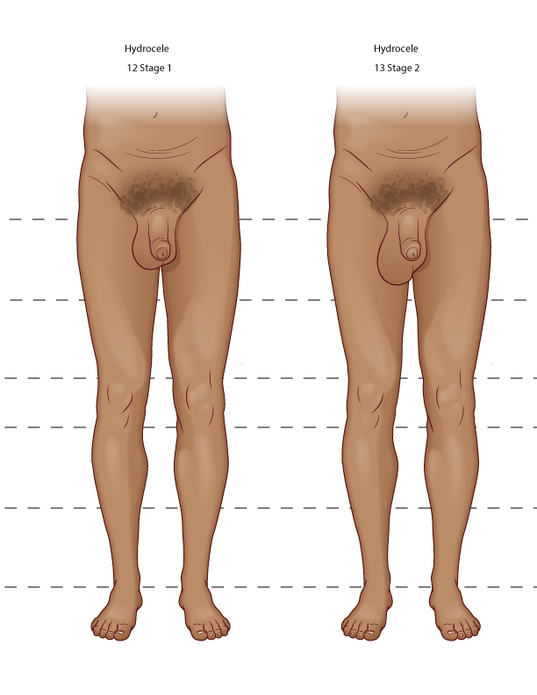
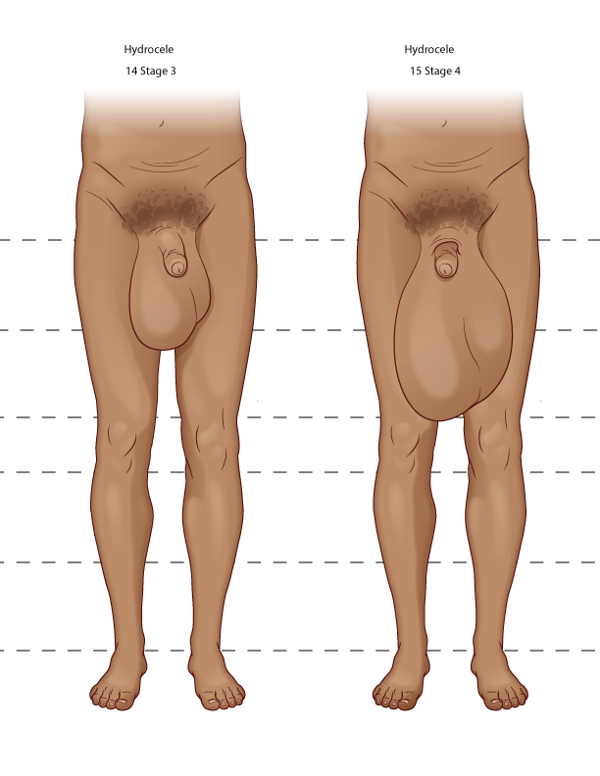
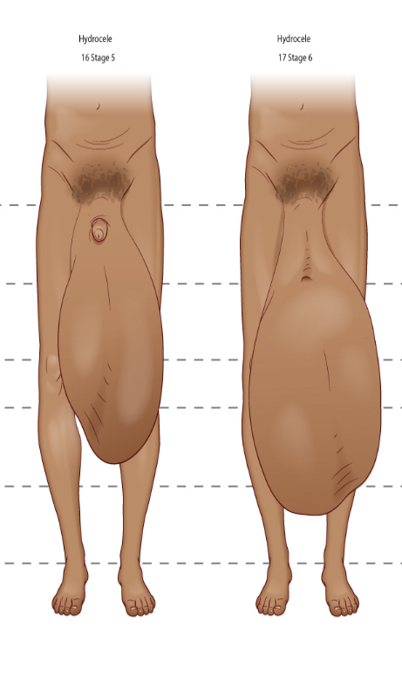
Staging of Hydrocele
Staging of hydrocele
STAGE 1
STAGE 2
STAGE 3
STAGE 4
STAGE 5
STAGE 6

Slide 24
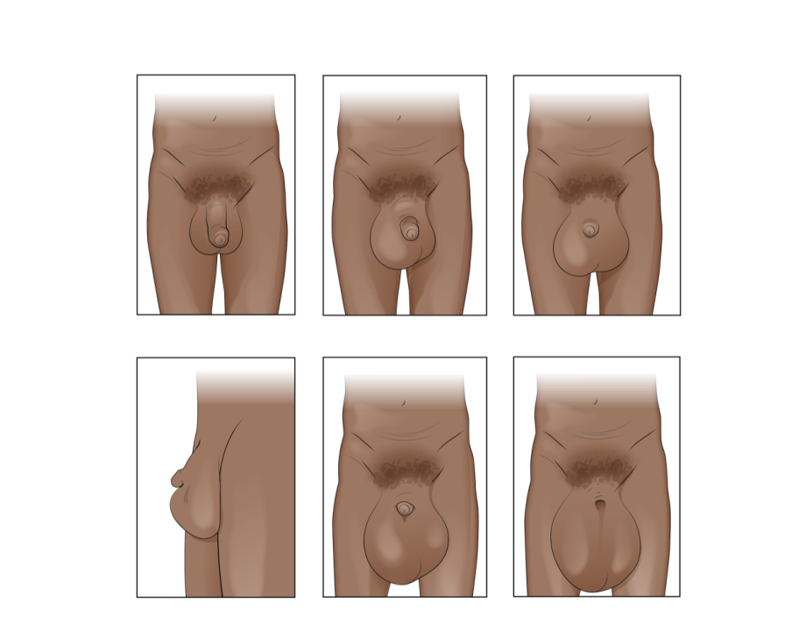
Grading of Hydrocele
GRADE 0
GRADE 1
GRADE 2 (face)
GRADE 2 (profile)
GRADE 3
GRADE 4

Slide 25
Session 8: Clinical Assessment

Slide 26
Clinical Assessment
Before filaricele surgery you must thoroughly:
Conduct a medical history and exam.
Conduct a scrotal exam to determine that the condition is Filaricele.
Determine if the cause of swelling is a different condition or is also present with Filaricele.
Determine any contra-indications to surgery.
Counsel and consent the patient.
Photo: William Nsai/Studio 3

Slide 27
Pre-Operative Screening
Clinical History
Patient overview
Medical history
Surgical History
Drug allergies
Habits
Physical Exam
General appearance
Blood pressure
Conjunctiva
Lab Tests
Hemoglobin
Glucose
HIV/AIDs
Filaremia
4. Scrotal Information
Duration of swelling
Side of the body swelling is on
Stage and grade of filaricele/hydrocele
Photo: William Nsai/Studio 3

Slide 28
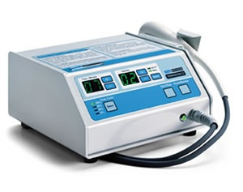
Pre-Operative Scrotal Examination
Correctly diagnosing filaricele requires differentiating a hydrocele from other conditions. The following are various methods for diagnosing filaricele:
Ultrasound
Ultrasound is the WHO recommended practice for diagnosis
Allows the surgeon to differentiate between other scrotal pathologies that may be contraindications for surgery
2. Transillumination
Where ultrasound is not available, transillumination can be used
Transillumination is non-specific
Palpation is often better at differential diagnosis

Slide 29
Pre-Operative Scrotal Examination
3. Palpation
A hydrocele mass usually has a palpable superior pole whereas a hernia has no superior pole.
There is usually a palpable tension or “resistance” of the hydrocele mass whereas a hernia is usually more mobile, softer, and decreases in size when a person is supine.
An epididymal or cord cyst has both superior and inferior poles that are distinct from the palpable testicle.
A testicular tumour is usually hard, whereas a cyst, hydrocele or hernia is usually soft. (Sometimes, however, a tumour will also have a hydrocele around it, in which case it might not be possible to differentiate it by physical examination alone.)

Slide 30
Other Scrotal Pathology
Testicular Tumour
May be surrounded by a hydrocele, so it may be difficult to diagnose on physical examination alone.
Testicular ultrasound is recommended for diagnosis, but there are physical distinctions as well.
Those found to have a testicular tumor should be referred to a Level III hospital.
The adjacent table shows diagnostic indicators of tumor.
 | Hydrocele | Tumor
History | Gradual, painless scrotal rather than testicular swelling. No history of trauma. | Painless or mildly painful testicular lump most commonly seen in adolescents or young men. Patient may first notice it after mild trauma.
Examination | Scrotum is translucent, smooth, non-tender; usually can be transilluminated. | Testis is heavy and firm. May have associated inflammation and erythema of the skin or reactive hydrocele.
Ultrasound | Clear fluid (except with chylocele or haematocele). Normal testicle – but note atrophic, calcific testis in cases of haematocele/chylocele. Atrophic testis will usually not have any areas of normal testis identifiable. | Usually heterogeneous enlarged mass within the normally homogeneous testis. When large, may affect the entire testis.
Source: Surgical approaches to the urogenital manifestations of lymphatic filariasis. Report from an informal consultation among experts, World Health Organization; 2019

Slide 31
Other Scrotal Pathology
Groin Hernia
Often can be diagnosed pre-operatively
Hernia is found in an estimated 6.0% of patients.
May occur on the same side or contralaterally to a hydrocele.
Surgeons should be prepared to repair inguinal/groin hernias while operating on a Filaricele.
Tension-free techniques are recommended in order to minimize recurrence.
Mesh repairs are recommended where possible.
Surgeons should ensure they have the necessary instruments and consumables on hand.

Slide 32
Other Scrotal Pathology
Varicoceles
Results from stasis of incompetent valves of the left spermatic vein
Typically present as a “bag of worms” on an ultrasound and are rarely uncomfortable but may have implications for fertility
They are rarely addressed surgically, but if they are it should be done at a Level III hospital or a facility with the proper human and surgical resources
Bilateral varicoceles may be an indication of malignancy and should be investigated further
Lymph Scrotum
Identified by thickening of the scrotal skin, rupturing superficial lymphatic vessels and draining lymph fluid
This condition may require scrotal reconstruction surgery and patients should be referred to Level III hospitals after treatment of any localized infection.
Notes:
For lymph scrotum, if there are no reconstructive experts in country, there are networks of surgeons available through telehealth platforms. One such example is the Société Internationale d’Urologique.
REMEMBER: should you encounter another pathology that you intended to repair with surgery at the same time as the filaricele surgery, you must consent the patient for both procedures

Slide 33
Referrals and the Health System
Some scrotal pathologies may be too complex and require specialized care. In these scenarios, it is important to know the appropriate level of the health system to refer them to. The chart below defines language used in this training:
Terminology | Synonym
First Level Hospital Basic care General practitioner or non-physician practitioner Limited beds and laboratory capacity | Primary level hospital District hospital Rural hospital Community hospital General hospital
Second Level Hospital More specialized care Staff typically includes surgeons and anesthetists | Regional hospital Provincial hospital
Third Level Hospital Specialized staff, equipment, and facilities Can serve large populations (300-1500 beds) | National hospital Central hospital Teaching hospital

Slide 34
Video: Clinical Assessment

Slide 35
Clinical Assessment

Slide 36
Clinical Assessment Questions
What is the importance of the clinical assessment?
Why is ultrasound preferred over transillumination?
Why is it important to check the penis and the leg, as well as the scrotum?
What is informed consent?
Why is it important to inform patients of the risks of surgery and get their consent?
What other aspects of counseling and consent would you add to the video?

Slide 37
Session 9: Management Plan and Contraindications for Surgery

Slide 38
Management Plan and Contraindicators
There are some situations where it is not advisable to operate, even if the patient has a filaricele.
Surgical Team Member Factors
Patient Factors
Environmental Conditions
Surgeon Factors
Notes:
Discussion here

Slide 39
Contraindications for Surgery
Surgeon Factors
Illness
Inebriation
Inadequate training
Impaired vision
Surgical Team Members
Lack of anesthetists
Inadequate training (particularly of anesthetists)
Patient Factors
Medical Risk Factors
High temperature (>37.5ºC) morning of surgery
Has more serious medical condition that the surgeon is not trained to address
Diagnosed with serious mental illness
Dementia
Severe tremors
Environmental Conditions
Inadequate lighting
Lack of proper tools
Missing resources
Lack of correct equipment
Lack of anesthesia resources to provide general anesthesia if needed

Slide 40
Developing a Management Plan
Assess patient’s overall health status and any contraindications.
Determine the socio-economic conditions of the patient and capacities of the health system.
Develop a plan that will address the patient’s health needs, considering what is feasible for them after they leave the hospital in the long-term.

Slide 41
Developing a Management Plan
Developing a management plan requires using all known data about the patient’s health status to determine the best course of care.
The management plan will involve not only the immediate care needs of the patient, but any long-term or post-operative care.
The intention of the management plan is to ensure patients have a thorough guide to ensure positive surgical outcomes and improved wellbeing.

Slide 42
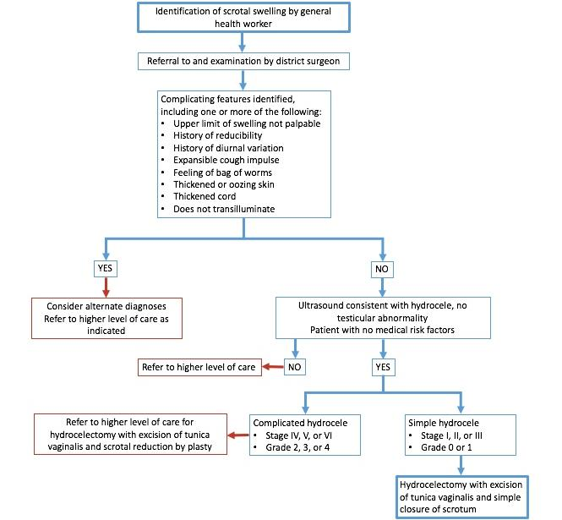
Algorithm for Surgical Planning
Notes:
Only reference this and let the participants know it will be part of the package of resources they will receive.

Slide 43
Hernia Repair and Orchiectomy
Hernia and necrotic testes are two common co-morbidities that you may need to treat surgically.
The chosen technique for hernia repair should
Pose a low risk of complications
Be within your surgical abilities and health center capabilities
Address the severity of the patient’s hernia
For more guidance on hernia repair, you can consult the international guidelines published by the HerniaSurge Group.
Orchiectomy may be necessary in cases of necrotic testis or, depending on the severity, testicular tumor.
Before conducting either of these procedures, check local protocols for referral to ensure the patient receives care at the appropriate level of the health system.
Notes:
Helpful Resources:
Essential Surgery textbook chapter on hernia and hydrocele: http://dcp-3.org/sites/default/files/chapters/DCP3_Essential%20Surgery_Ch9.pdf
“International guidelines” for hernia repair: https://www.ncbi.nlm.nih.gov/pmc/articles/PMC5809582/

