Slide 1
3b. Filaricele Surgery Training Presentation Section B
This presentation is one component of a larger resource package titled Filaricele Surgery Training Package.
The presenter/facilitator should read and be familiar with the other components of the resource package before delivering this presentation – particularly 2. Facilitator’s Guide for Filaricele Surgery Training.
To effectively deliver this content, the presenter/facilitator must have technical knowledge of hydrocele surgery, equivalent to that of a technical supervisor or national trainer.

Slide 2
TRAINING ON FILARICELE SURGERY
Section B

Slide 3
Session 10: Ensuring a Safe Surgical Environment

Slide 4
Ensuring a Safe Surgical Environment
Evidence shows that a contaminated health care environment plays a significant role in the transmission of microorganisms. It is essential that:
the operating room is thoroughly cleaned on a daily basis
proper mechanical ventilation is also necessary to prevent surgical wound contamination from unfiltered air drawn into the operating room (OR)
Notes:
These are pulled directly from the WHO SSI guidelines.

Slide 5
Ensuring a Safe Surgical Environment
General principles for environmental cleaning:
Cleaning is an essential first step prior to any disinfection process to remove dirt, debris and other materials.
The use of a neutral detergent solution is essential for effective cleaning.
If disinfectants are used, they must be prepared and diluted according to the manufacturer’s instructions. Too high and/or too low concentrations reduce the effectiveness of disinfectants.
Notes:
These are pulled directly from the WHO SSI guidelines

Slide 6
Importance of a Clean Environment
Cleaning should always start from the least soiled areas (cleanest) first to the most soiled areas (dirtiest) last and from higher levels to lower levels so that debris may fall on the floor and is cleaned last.
Detergent and/or disinfectant solutions must be discarded after each use.
Avoid cleaning methods that produce mists or aerosols or disperse dust, for example dry sweeping (brooms, etc.), dry mopping, spraying or dusting.
Routine bacteriological monitoring to assess the effectiveness of environmental cleaning is not required, but may be useful to establish the potential source of an outbreak and/or for educational purposes.

Slide 7
Cleaning Requirements
Surface Type | Cleaning Requirements
High hand-touch surface | Requires special attention and more frequent cleaning. After thorough cleaning, consider the use of appropriate disinfectants to decontaminate these surfaces.
Minimal touch surface (floors, walls, ceilings, window sills, etc.) | Requires cleaning on a regular basis with detergent only or when soiling or spills occur. Also required following patient discharge from the health care setting.
Medical and other equipment | Require cleaning according to written protocols. This should include the use of appropriate personal protective equipment, cleaning methods conforming to the type/s of surface, and cleaning schedules. Training must be provided to all cleaning staff. Refer to the manufacturer’s instructions for medical equipment
Surface contaminated with blood and body fluids | Requires prompt cleaning and disinfection.

Slide 8
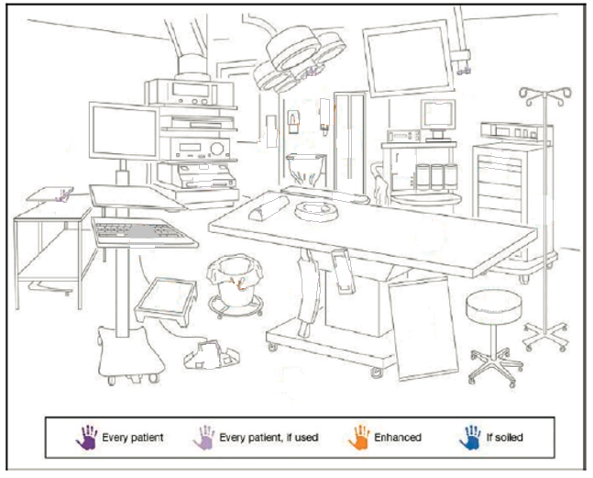
Global guidelines for the prevention of surgical site infection, second edition. Geneva: World Health Organization; 2018.

Slide 9
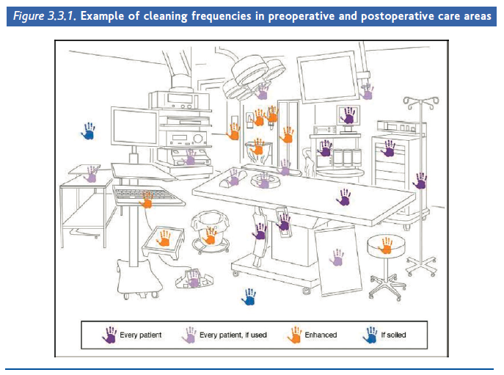
Hygienic Environment

Slide 10
Enabling a Safe Surgical Environment
Operating facilities should have access to adequate clean water and personal hygiene stations.
Hand washing stations with soap should be available pre- and post-surgery.
The OR should have ample lighting (including an overhead light) and a power back-up system if possible.
If you do not have access to these resources at your facility, consider referring to a higher-level facility that may be better equipped.

Slide 11
Prevention of Surgical Site Infection
Intra-operative Measures
Surgical Hand Preparation
Surgical hand preparation is vitally important to maintain the lowest possible contamination of the surgical field, especially in the event of sterile glove puncture during the procedure.
The hands of the surgical team should be clean upon entering the OR by washing with a non-medicated soap. Once in the operating area, perform surgical handwashing by using a suitable alcohol-based handrub before donning sterile gloves; the use of a surgical brush is not recommended.
Notes:
Moderate quality evidence shows the equivalence of handsrubbing with an ABHR and handscrubbing with antimicrobial soap and water for surgical hand preparation for the prevention of SSI.

Slide 12
Notes:
Once again, reference this sheet and continue on. They will have access to it in the resource package.

Slide 13
Sterilization
Surgery involves creating a wound and thus exposes the patient to the risk of infection, and the possibility of transmission of infection between health staff and patient and subsequent patients if sterile practices are not followed:
All items used as a part of the sterile field for surgery or an aseptic change of dressing must be sterile.
Once an item is removed from a sterile wrapper or sterilizer, it must be used, discarded, or re-sterilized. Items should be considered unsterile if there is any doubt about their sterility.
If an unsterile person or item touches a sterile object, the object is considered contaminated and no longer sterile.
STERILE CARE MUST NOT BE PERFORMED IF THE INSTRUMENTS CANNOT BE PREPARED AND STERILIZED AS RECOMMENDED

Slide 14
Sterilization
Wear protection, at a minimum gloves, during this process:
Cleaning:
Wash the instruments/items with water and soap. Rinse carefully and dry them.
Decontamination
Sterilization :
AUTOCLAVE
Dry heat sterilizers are also acceptable
Decontamination with chlorine is NOT recommended as it damages instruments and creates risk for staff.
Notes:
It should be noted that recent WHO guideline on prevention of site infection (2016) says that decontamination with Chlorine prior to the cleaning of instruments is not recommended anymore, due to the corrosive effect of chlorine, and the risks associated for health staff workers with the transportation and manipulation of decontamination material. However, (as decontamination is done to reduce the risk of contamination of health staff during cleaning process) in this case, automated cleaning is recommended, or manual cleaning done by health staff wearing full personal protective (heavy duty gloves, goggles, apron…)

Slide 15
Resources for Environmental Preparation
WHO Guidelines on Hand Hygiene
WHO Guidelines on Prevention of Surgical Site Infections

Slide 16
Hygienic Environment

Slide 17
Hygienic Environment Questions
What are the general principles for environmental cleaning?
What are the risks to patients and health care providers if surgical surfaces are not cleaned on schedule?
What are the risks to patients and health care providers if instruments are not sterilized properly?
Why is it important to have the equipment and human resources available to closely monitor the patient during surgery?

Slide 18
Session 11: Team Process and the Surgical Environment

Slide 19
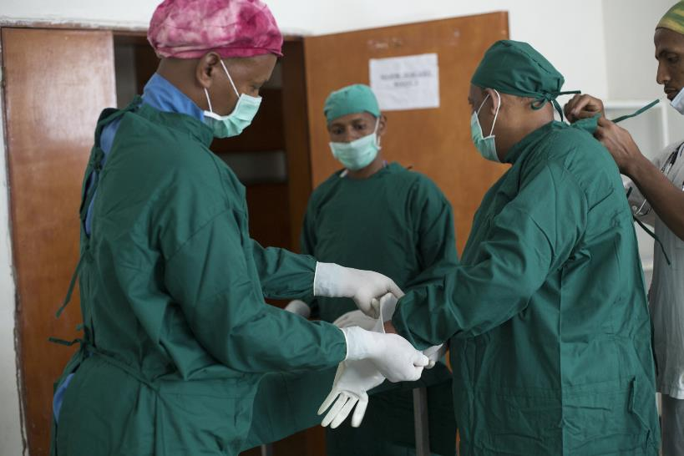
Team Process and the Surgical Environment
Team Process: those tasks that are carried out or require the input of the entire surgical team
What are some examples of team processes in surgery?
Photo: William Nsai/Studio 3
Notes:
Team processes include timeout/checklists, decontamination, and waste disposal.
Surgical teams should have standardized processes in place to ensure the environment is clean and to improve outcomes for rocele surgery.

Slide 20
Session 12: Preparing the Operating Room

Slide 21
Preparing the Operating Room
Hydrocele surgeries should be conducted in a proper operating room. When preparing the operating room for surgery, ensure that you prepare the following:
The operating room
Cautery
The sterile equipment table
Operating bed
The dustbin
The sharps bin
The surgeon’s trolley
The surgical set
**As you are setting out the instruments, be sure to count all sharps and gauze prior to surgery.

Slide 22
Video: Preparing the Operating Room

Slide 23
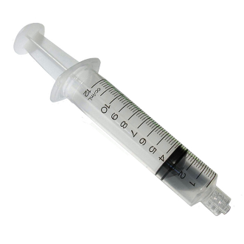
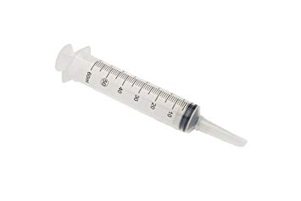
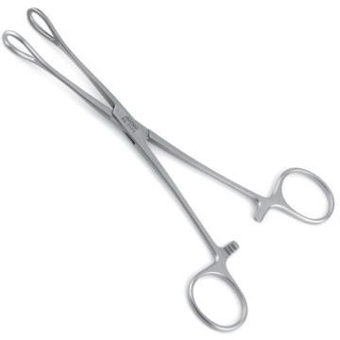
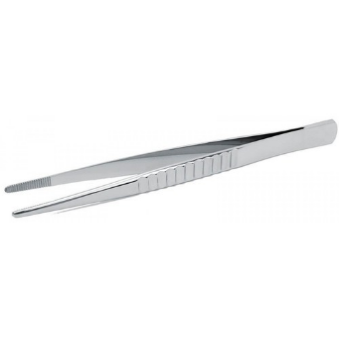
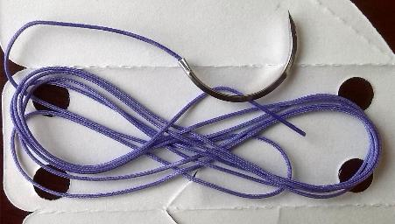
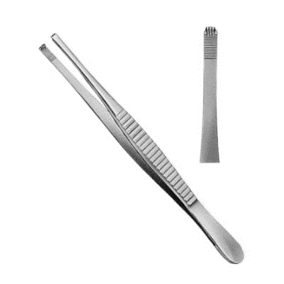
Instruments
Leur Lock Syringe (10ml)
Catheter Tip Syringe (60ml)
Sponge Forceps
Non-toothed, dissecting forceps
Absorbable, polyglactin suture (Vicryl)
Toothed, dissecting forceps

Slide 24
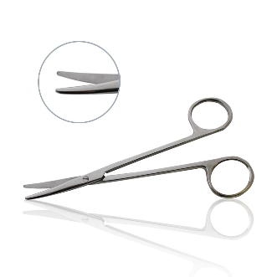
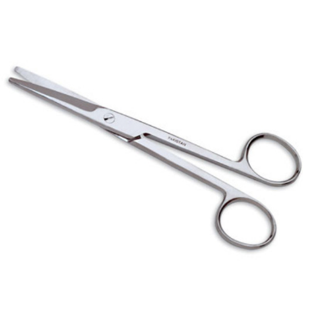
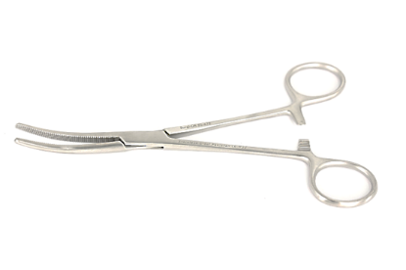
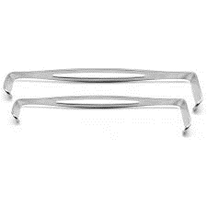
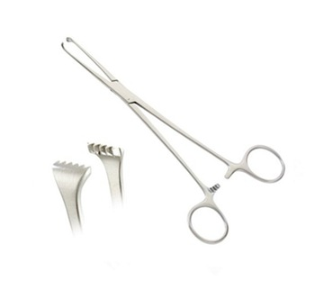
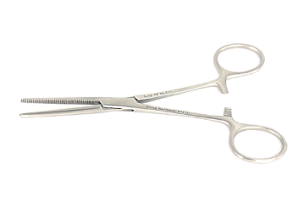
Instruments
Metzenbaum scissors
Mayo scissors
Curved Artery Forceps
Retractors
Allis clamps
Straight Artery Forceps
*Other instruments will need to be procured for hernia repair

Slide 25
Procurement Calculator for Hydrocele Surgery
Available Resource:
Procurement Calculator for Hydrocele Surgery, developed by the MMDP Project
Quantifies the amounts of drugs, disposable materials, and durable goods for high-quality hydrocele surgery
Includes a provision for hernias.

Slide 26
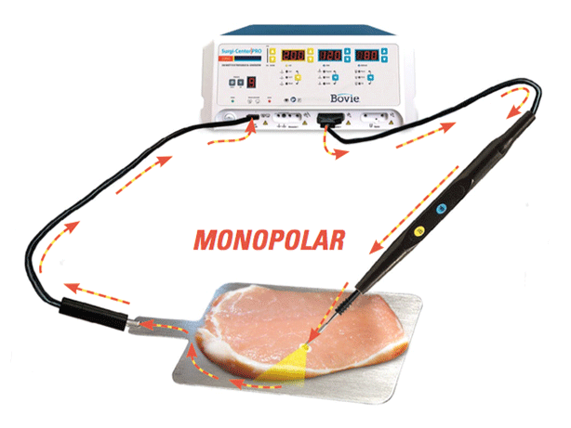
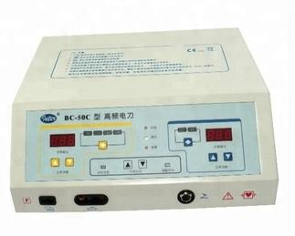
Cautery Machine
When available, it is recommended that a monopolar cautery machine with cut and coagulation settings be used to seal circulatory and lymphatic vessels.
Cautery machines supplement surgical techniques for hemostasis; they do not replace them.

Slide 27
Session 13: Sharps Management

Slide 28
Video: Sharps Management

Slide 29
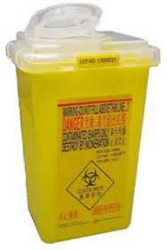
Sharps Management
Remember: To avoid accidental needle pricks, do not bend, break or recap needles prior to disposal.
The container should be placed at the point of use so that health care workers do not have to carry sharp items.
The risk of injury with sharp objects increases with the distance they are carried and the amount they are manipulated.

Slide 30
Sharps Management (continued)
Container for the safe disposal of sharp objects should be:
Well labelled
Puncture proof, watertight, and break resistant
Opening large enough to pass needles and scalpel blades, but never large enough for someone to reach into
Secured to a surface, such as a wall or counter, to ensure stability during use
Removable for disposal
These containers must then be treated and disposed of safely.

Slide 31
Session 14: Pre-Operative Care and Prevention of Surgical Site Infections

Slide 32
Video: Pre-Operative Care

Slide 33
Video: Patient Preparation

Slide 34
Pre-Operative Care
Pre-Operative Measures
Pre-operative Bathing
Bathe or shower the day before the surgery AND the morning of the surgery. The objective is to ensure that the skin is as clean as possible and to reduce the bacterial load, especially at the site of incision. Either a plain or antimicrobial soap may be used for this purpose.
Pre-operative Surgical Antibiotic Prophylaxis (SAP)
SAP refers to the prevention of infectious complications by administering an effective antibiotic prior to exposure to contamination during surgery. The benefit of the routine use of SAP prior to surgery to prevent Surgical Site Infection has long been recognized.
Antibiotics should be given within one hour prior to surgery and, in cases of more complex filaricele, after surgery at a time appropriate to the antibiotic being used. Antibiotic choice should be informed by prevalence patterns of resistant bacteria.
Notes:
Antibiotics are not recommended beyond one dose just before surgery for uncomplicated hydroceles in healthy patients. A typical protocol might include a first-generation cephalosporin in combination with an aminoglycoside given within one hour before starting surgery in order to cover typical skin and enteral bacteria.
For higher stage hydroceles, postoperative antibiotics may be beneficial based on preoperative skin cultures, scrotal skin thickness, and other considerations such as patient nutritional status and environmental conditions. The choice of antibiotics should be governed by local patterns of bacteria and antibiotic resistance as well as availability of medication at local facilities. Broad spectrum antibiotics should be avoided to reduce risk of antimicrobial resistance. In surgical camps where antibiotics are given per protocol, careful follow-up should be implemented and coordinated with hospital-based infection control systems.

Slide 35
Preventing Surgical Site Infections
Pre-Operative Measures
Clipping of Hair
It is recommended that in patients undergoing hydrocele surgical procedure, scrotal hair should be removed only with a clipper or scissors.
Shaving is always strongly discouraged, whether preoperatively or in the operating room
In the operating room it is recommend­ed that close clipping be done as little as necessary to clear the surgical field.
Only cut as much hair as necessary to ensure the surgery can be done safely but try not to remove all the hair if possible.

Slide 36
Preventing Surgical Site Infections
Intra-Operative Measures
Surgical Site Preparation
Surgical site preparation refers to the preoperative treatment of the intact skin of the patient with soap and then a disinfectant within the OR. Preparation includes not only the immediate site of the intended surgical incision, but also a broader area of the patient’s skin.
The aim of this procedure is to reduce the microbial load on the patient’s skin as much as possible before incision of the skin barrier.
Notes:
Moderate quality evidence shows the equivalence of handsrubbing with an ABHR and handscrubbing with antimicrobial soap and water for surgical hand preparation for the prevention of SSI.

Slide 37
Pre-Operative Care

Slide 38
Pre-Operative Care Questions
Why is it important to count the number of gauze and sharps prior to surgery?
What two factors increase a health care provider’s risk of injury when handling sharps?
What are the benefits of washing and disinfecting the surgical site prior to surgery?
Why shouldn’t you shave the hair around the surgical site?
What other steps, not mentioned here, should be taken to avoid surgical site infections?
Why might there be an increased concern about surgical site infections with those who have hydrocele resulting from LF infection?

Slide 39
Session 15: Anesthesia

Slide 40
Video: Anesthesia

Slide 41
Anesthesia
Choice of Anesthesia
Nonsteroidal anti-inflammatory medications (NSAIDs) are not recommended until after surgery.
Pre-operative Meds
1st gen cephalosporin and Gentamicin (or Tobramycin) are recommended.
Antibiotics should be given within one hour before surgery.
Pre-operative Anesthesia
Local anesthesia is preferable in most cases.
Spinal anesthesia should only be given when a trained staff member is available.
General anesthesia should be available if:
Necessary to extend the surgical time
Pain control cannot be managed with local anesthesia

Slide 42
Session 16: Surgical Technique

Slide 43
Surgical Techniques
The following video will demonstrate two different surgical techniques for filaricele surgery:
Resection (or Excision)
Eversion
The choice of technique should be informed by and adapted to local practices, taking into account surgeon training.

Slide 44
Video: Surgical Techniques

Slide 45
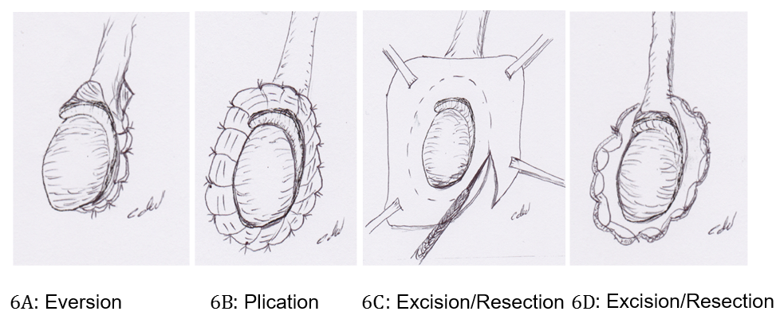
Techniques for the Tunica Vaginalis

Slide 46
Session 17: Cleaning Up After Surgery

Slide 47
Cleaning Up After Surgery
The purpose of waste management is to:
protect people who handle waste items from accidental injury
prevent the spread of infection to health care workers who handle the waste
prevent the spread of infection to the local community
safely dispose of hazardous materials (toxic, chemicals…)
Main Principles
The disposal of Health Care Waste is time consuming and expensive, so it is important:
To separate non-contaminated material such as waste paper, packaging and non-sterile but not biologically contaminated materials
Make separate disposal containers available where waste is created so that staff can sort the waste as it is being discarded
Organize waste management in a way to discourage the need for people to be in contact with contaminated waste

Slide 48
Video: Cleaning Up After Surgery

Slide 49
How to Dispose of Solid Contaminated Waste
All infected waste should then be treated by incineration.
Incinerators must be operated in accordance with local regulations.
Incineration is the ideal method for the final disposal of waste; the ashes remaining after combustion may also pose an environmental risk (soil and water pollution) and must also be buried safely.
Remember:
Never use hands to compress waste into containers.
Hold plastic bags at the top.
Keep bags from touching or brushing against the body while lifting or during transport.
Open burning is not recommended because it is dangerous, unsightly, and the wind will scatter the waste. If open burning must be done: burn in a small, designated and secured area; transport waste to the site just before burning, and remain with the fire until it is extinguished.

Slide 50
How to Dispose of Solid Contaminated Waste
Waste Storage
Maintenance staff must be informed about the potential risks they face when handling waste.
They must be trained to safely manage biomedical waste and must wear protective garments (gloves/aprons).
Waste must be collected daily and stored appropriately. Contaminated or dangerous waste should be stored in a locked area. The waste should not be stored near patients or areas where food is prepared.
Contaminated waste must be stored for a maximum of:
72 hours in a cold climate
48 hours in a warm climate
24 hours in a hot climate

Slide 51
Session 18: Dressing and Bandaging

Slide 52
Dressing and Bandaging
This video will cover the process of dressing and bandaging the surgical site after the operation.
The video covers:
Washing with chlorhexidine*
Longitudinal compress
*If chlorhexidine is not available, a povidone-iodine solution can be used.

Slide 53
Video: Dressing and Bandaging

Slide 54
Session 19: Post-Operative Care

Slide 55
Post-Operative Care
Antibiotic Coverage
To avoid antibiotic resistance, it is recommended that antibiotics not be given post-operatively.
Higher stages and grades of hydrocele, however, may warrant more antibiotic coverage.
In such situations, it is recommended that a sample from the “buried penis” cavity be taken in order to ascertain the best combination of antibiotics relative to microflora and local availability of antibiotics.

Slide 56
Post-Operative Care
Post-Operative Analgesia
Diclofenac 50mg, 3 times/day for 2 days OR Ibuprofen 400 mg 3 times/day for 2-3 days
Note: NSAID use should be cautioned for patients who are hypertensive, diabetic or old – because of an increased risk of acute renal insufficiency that may not be dose-dependent – and in patients with a history of dyspepsia.

Slide 57
Post-Operative Care
[note: confirm the latest WHO guidelines/dosage before using this slide]
Microfilaria-positive Patients
Patients who are microfilaria positive should also be treated with:
6 mg/kg of body weight diethylcarbamazine (DEC) AND Albendazole 400 mg p.o.
In some settings, it is recommended that the two drugs above should also be combined with Ivermectin (Mectizan) 200 mg p.o. Check with your national program to determine the best course of treatment.
In areas endemic for loiasis, only albendazole should be given to avoid complications. In areas endemic for onchocerciasis, only ivermectin and albendazole should be given.

