Slide 1
3c. Filaricele Surgery Training Presentation Section C
This presentation is one component of a larger resource package titled Filaricele Surgery Training Package.
The presenter/facilitator should read and be familiar with the other components of the resource package before delivering this presentation – particularly 2. Facilitator’s Guide for Filaricele Surgery Training.
To effectively deliver this content, the presenter/facilitator must have technical knowledge of hydrocele surgery, equivalent to that of a technical supervisor or national trainer.

Slide 2
TRAINING ON FILARICELE SURGERY
Section C

Slide 3
Session 20: Follow-Up Care

Slide 4
Follow-Up Care
Close post-operative follow-up is essential because any post-operative infection can very quickly become dangerous in this warm, moist part of the body, even more so in a tropical climate under conditions where access to resources for personal hygiene is low.
The following video will review:
Technique for dressing changes
Timing of dressing changes
What to look for during post-operative follow-up
Hospital admission recommendations post-operatively

Slide 5
Video: Follow-Up

Slide 6
Day 1-2 Post Surgery
YES
Day 1-2: Any indication of Hemorrhage and Hematoma?
NO
For hemorrhage, start tranexamic acid immediately after bleeding or hematoma is observed (1g x 2/day for 3-5 days and change dressing).
If patient complains of severe pain in scrotum or dizziness, take grouping sample for transfusion.
Transport to OR to restore hemostasis.
Do not remove dressing.

Slide 7
Day 3-5 Post Surgery
YES
Day 3-5: Any indication of infection?
NO
If patient has fever or wound is wet, put on course of antibiotics and change dressing daily.
Document possibility of infection.
Aseptic dressing change
Continue supportive taping.

Slide 8
Day 7 Post Surgery
YES
Day 7: Any indication of infection?
NO
If wound looks infected and wet, take culture and test for sensitivity to antibiotics.
Prescribe antibiotics for 7 days (longer may be needed depending on antibiotic and response).
Continue to change dressing daily until wound is not wet, then change once every other day.
Aseptic dressing change
Remove supportive taping

Slide 9
Day 14 Post Surgery
YES
Day 14: Any indication of infection?
NO
If wound looks infected and wet, take culture and test for sensitivity to antibiotics.
Prescribe antibiotics for another 7 days.
Examine the scrotum.
Make appointments for continued follow-up for the next 12 months.

Slide 10
Months 1-12 Post Surgery
YES
Any indication of recurrence?
NO
Refer to Level III health facility for surgery.
Continue with follow-up appointments.

Slide 11
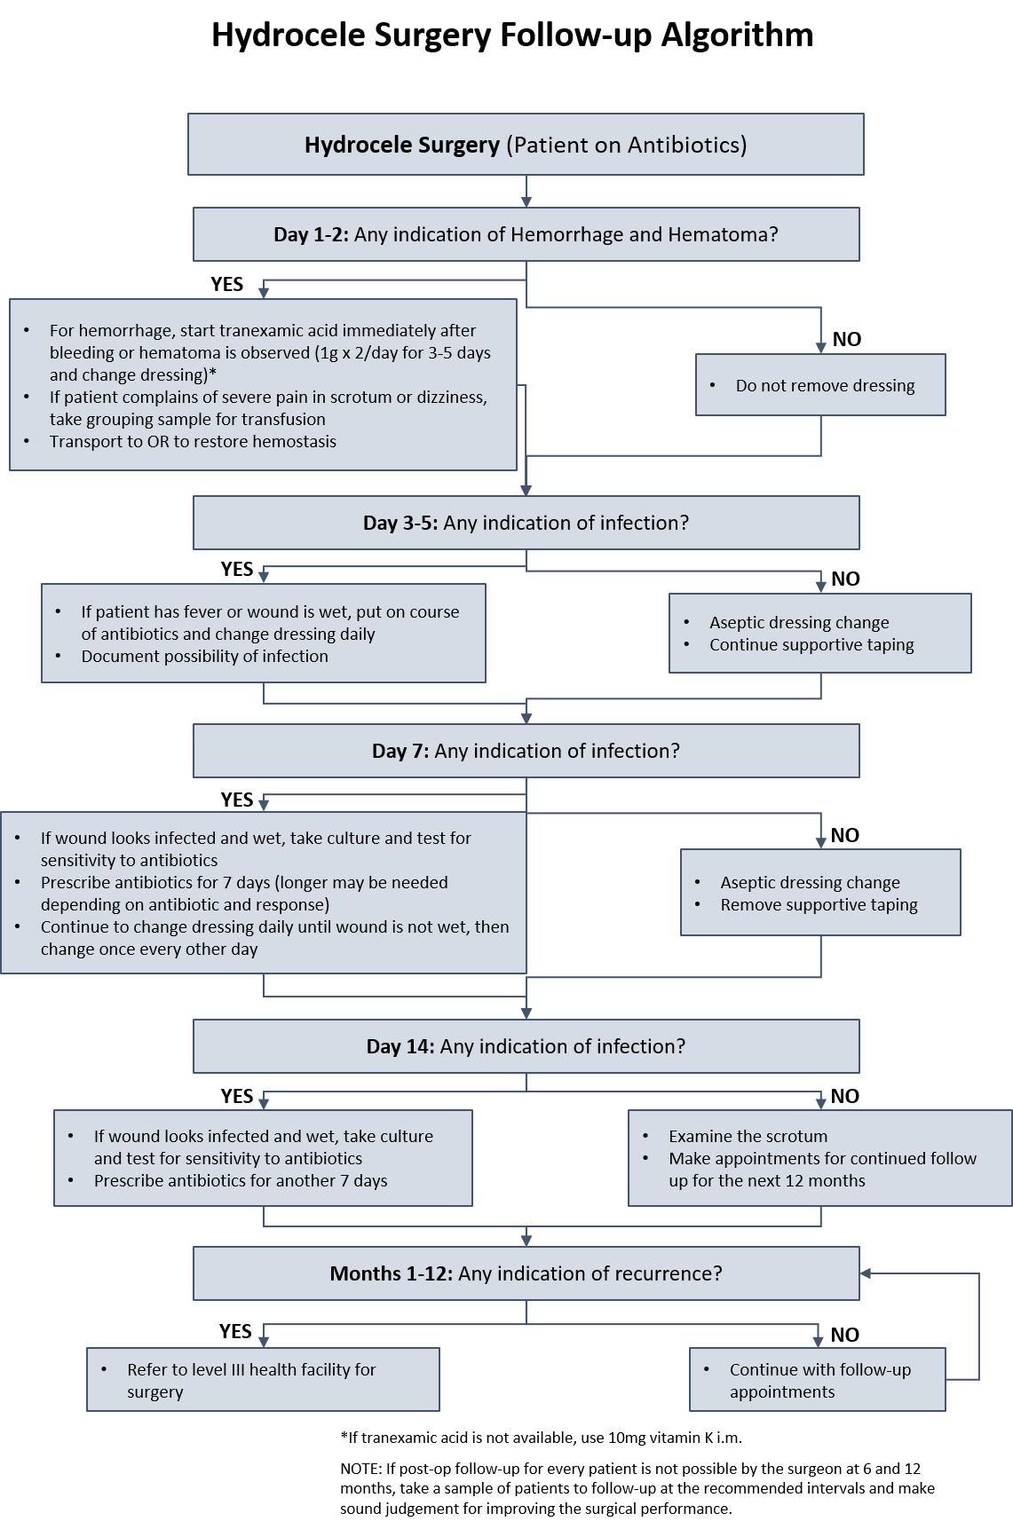
Follow-Up Care

Slide 12
Session 21: Surgical Complications

Slide 13
Surgical Complications
Recurrence
Recurrence of filaricele can be a problematic complication resulting from surgery.
Care should be taken to ensure lymphatic vessels are not ruptured during surgery and are cauterized or sealed prior to finishing the procedure.
Recent research indicates that excision may lead to less likelihood of recurrence, but more research needs to be done.
Hematoma
Can be avoided by ensuring hemostasis before closing the incision and by providing supportive bandaging for the surgical wound.
If hematoma develops, it is best not to drain it because it could cause infection.
It should resolve over time and patients should be instructed to wear supportive underwear, elevate and avoid strenuous activity for two weeks.

Slide 14
Surgical Complications
Infection and Wound Dehiscence
If infection occurs, ensure adequate drainage, clean frequently, and change the dressing often
Serious infections should be treated with systematic antibiotics,
In the case of wound dehiscence, attempts should not be made to close the wound, but you should ensure that it is kept clean and dressed.

Slide 15
Notes:
Example of normal healing

Slide 16
Notes:
Example of hematoma

Slide 17
Notes:
Example of suppuration

Slide 18
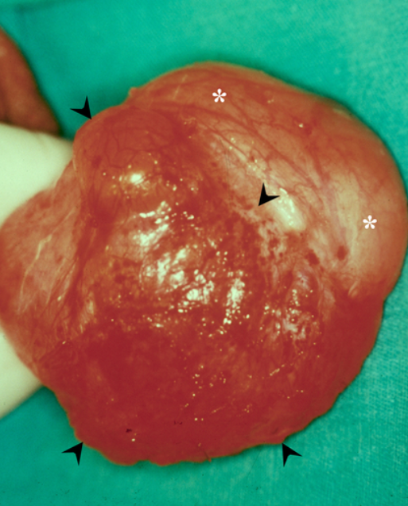
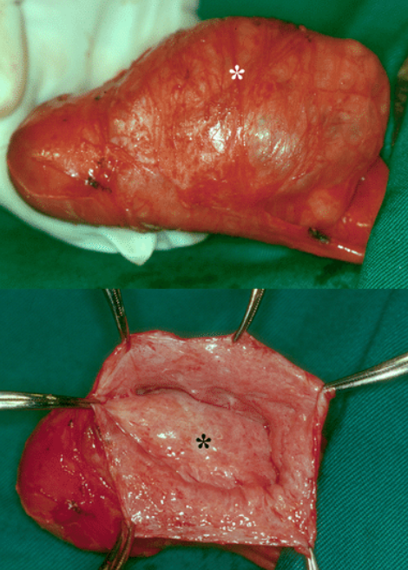
Source: Norões, Joaquim & Dreyer, Gerusa. (2010). A Mechanism for Chronic Filarial Hydrocele with Implications for Its Surgical Repair. PLoS neglected tropical diseases. 4. e695. 10.1371/journal.pntd.0000695.
Notes:
Example of recurrence
Left image: Posterior recurrent hydrocele sac (arrow heads) and anterior surface of the testis (asterisks);
Right top image: Recurrent hydrocele sac situated anterior to the testis (asterisk)
Right bottom image: Opened recurrent hydrocele sac showing the anterior surface of the testis covered by tunica albuginea and visceral layer of tunica vaginalis (asterisk). By gross appearance the testicle is abnormal in shape and size. The sac wall (forceps) and testicular tunicas appear thick and with irregular surfaces.

Slide 19
Session 22: Discharge and Long-Term Follow-up

Slide 20
Discharge Instructions
Give patient information about hygiene, bandage management, and follow-up visits, as well as patient satisfaction, concerns, and potential problems for future management.
It is recommended that instructive documents include the following information:
Date to remove the dressing
How to wash and re-dress the wound
How to take pain medication (if necessary)
When to return for follow up
How to contact surgical team in case of issues
Instructive materials should include pictures when possible and be printed in the patient’s language.

Slide 21
Long-Term Follow-up
Ideally, follow-up should be conducted at the following intervals:
1 month
3 months
6 months
1 year
3 – 5 years

Slide 22
Video: Long-Term Follow-up

Slide 23
Follow-up Discussion
How does long-term follow-up and data collection benefit larger LF elimination efforts?
How does close pre-operative care affect surgical outcomes?
What information that you gathered when creating the management plan would you use to develop a post-surgery follow-up plan?

Slide 24
Session 23: Training Summary and Workshop Conclusion

Slide 25
Summary of Preferred Practices
Nomenclature
The staging and grading system presented here from Capuano and Capuano is the recommended standard nomenclature.
Diagnosis and differential diagnosis
Ultrasound is the preferred form of diagnosis because it can help distinguish between “simple” hydroceles and complex variants.
Transillumination is inferior to ultrasound in differentiating hydrocele from other scrotal pathology.
Surgical Team Process
Use WHO Surgical Safety Checklist.
Proper instrument care and waste disposal is important for patient and staff safety.

Slide 26
Summary of Preferred Practices
Surgical Technique
Resection/excision of the tunica vaginalis is preferred for all stages of LF hydrocele.
Surgeons should be prepared for hernia repair; mesh is recommended if available.
Electrocautery using diathermy is preferred in addition to suturing and vessel ligature for hemostasis.
Parenteral antibiotics should be given within one hour before incision.
Post-operative Care
There should be a standardized care plan in place that can be tailored to the patient.
Care plan should allow evaluation of outcomes as well as reporting.

Slide 27
Hydrocele Surgery Indicators
The MMDP Project has developed a questionnaire including a chart review and a patient interview to be administered at Day 5 that covers all the recommended indicators including:
Hemorrhage
Hematoma
Infection
An additional questionnaire was also developed with a patient exam and interview at ~month 9. The questionnaire includes questions on recurrence, as well as any changes in the quality of life as perceived by the patient.

Slide 28
THANK YOU
“Although the world is full of suffering, it is also full of overcoming it.” -Helen Keller

