Slide 1



5b. Presentation for Reviewing Photos
[This slide to be removed before presentation is used.]
This presentation is one component of a larger resource package titled Photographing Eyelids Before and After Trachomatous Trichiasis (TT) Surgery.
The presenter/facilitator should read and be familiar with the other components of the resource package before delivering this presentation – particularly 5a. Facilitator’s Guide for Reviewing Photos with Forms.
To effectively deliver this content, the presenter/facilitator must have technical knowledge of TT surgery, equivalent to that of a technical supervisor or national trainer, that enables him/her to assess operated eyelids and provide detailed technical feedback to surgeons.

Slide 2
Reviewing Photos of Eyelids
Before and After
Trachomatous Trichiasis (TT) Surgery

Slide 3
Session 1:
Group Review of Photos
Facilitated by a technical supervisor

Slide 4
Introduction
  To discuss:
  What are the objectives of integrating photo taking into the surgical process?
Notes:
The facilitator begins by asking the participants to state what they feel are the objectives of integrating photo taking into the surgical process and writes the responses on flip chart paper.
When all participants have contributed, the facilitator reviews the responses, asking for comments from each participant who explains his/her agreement with the suggestion and the ‘why’ or ‘why not.’
If not mentioned by participants, facilitator should introduce the following potential objectives into the discussion:
To increase the potential for higher quality outcomes of TT surgery
To improve individual surgeon awareness of areas in need of strengthening
To provide an opportunity for surgeons to assess their own performance and identify areas to strengthen
To predict the surgical outcome based upon immediate post-surgical result
To be able to assess the results of the surgery while the operated case is still available to make necessary adjustments to improve long-term outcome and avoid complications

Slide 5
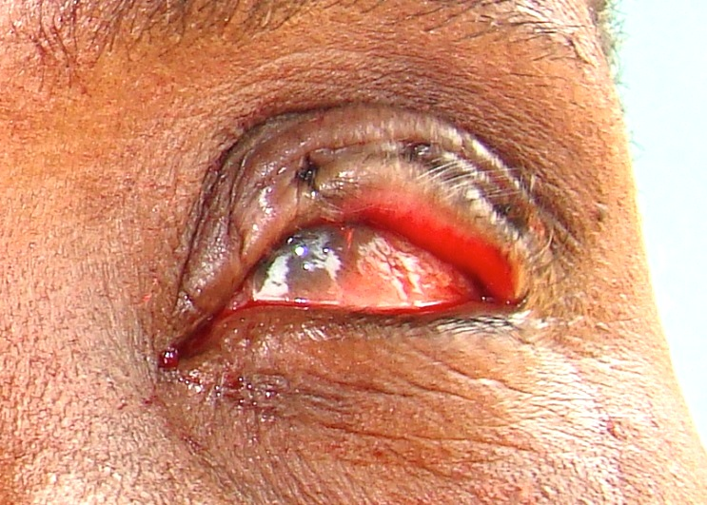
Example 1: Overcorrection
Immediate Postoperative Photo
Notes:
The facilitator presents the first example IPO photo, asking the participants to take a few minutes to observe.
The facilitator asks the participants how they would assess the surgery, highlighting any positives or potential problems while writing responses on flip chart paper.
Sample questions to pose to the group include:
What are the positive surgical aspects of this eyelid?
What potential problems are present in this eyelid?
The facilitator should be prepared to draw the participants’ attention to critical details of the IPO photo if they are not mentioned by participants.
The facilitator asks the participants what, based on the potential problems identified, they would expect to see when the operated case is followed up with 3-6 months later.

Slide 6
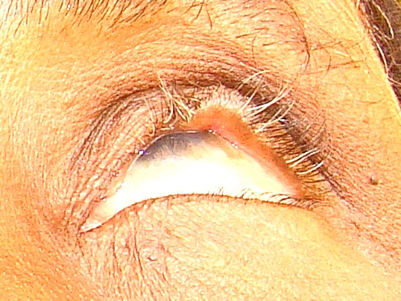
Example 1: Overcorrection
Follow-up Photo (one year later)
Notes:
The facilitator presents the FPO photo, asking the participants what they observe and discussing the expectations they named during the previous step.
Sample questions to pose to the group include:
What can one observe about this eye 3-6 months post-operatively?
How do these observations agree with the expectations based on the IPO photo?

Slide 7
Example 1: Overcorrection
Both Photos
Notes:
The facilitator presents the IPO and FPO photos side-by-side and asks the participants what, given the FPO photo results, could have been done either during surgery or immediately post-operatively to reduce the chances of a poor outcome.
Sample questions to pose to the group include:
In looking at this photo, what could have been done while the patient was on the table to allow for a better outcome?

Slide 8
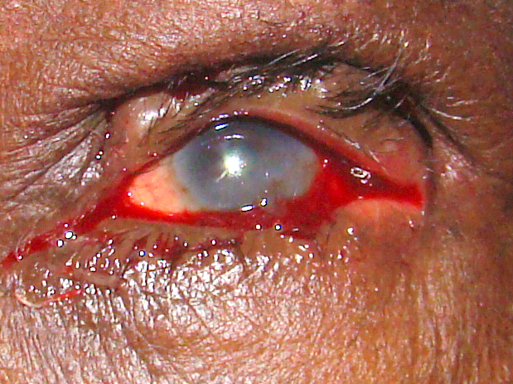
Example 2: Under correction
Immediate Postoperative Photo
Notes:
The facilitator asks the participants how they would assess the surgery, highlighting any positives or potential problems while writing responses on flip chart paper.
Sample questions to pose to the group include:
What are the positive surgical aspects of this eyelid?
What potential problems are present in this eyelid?
The facilitator should be prepared to draw the participants’ attention to critical details of the IPO photo if they are not mentioned by participants.
The facilitator asks the participants what, based on the potential problems identified, they would expect to see when the operated case is followed up with 3-6 months later.

Slide 9
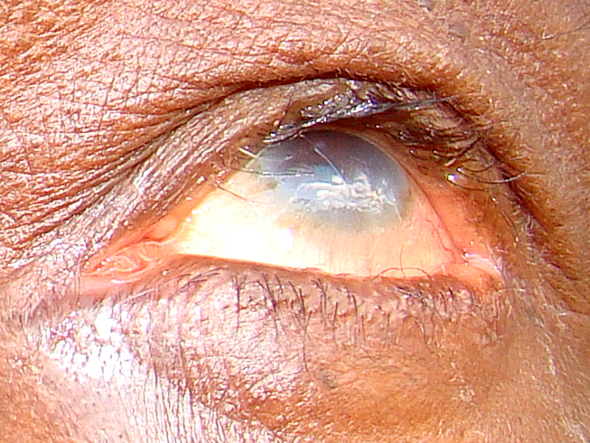
Example 2: Under correction
Follow-up Photo (one year later)
Notes:
The facilitator presents the FPO photo, asking the participants what they observe and discussing the expectations they named during the previous step.
Sample questions to pose to the group include:
What can one observe about this eye 3-6 months post-operatively?
How do these observations agree with the expectations based on the IPO photo?

Slide 10
Example 2: Under correction
Both Photos
Notes:
The facilitator presents the IPO and FPO photos side-by-side and asks the participants what, given the FPO photo results, could have been done either during surgery or immediately post-operatively to reduce the chances of a poor outcome.
Sample questions to pose to the group include:
In looking at this photo, what could have been done while the patient was on the table to allow for a better outcome?

Slide 11
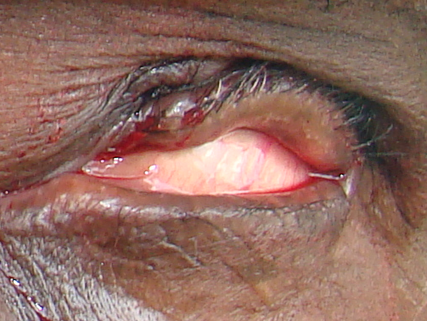
Example 3: Incorrect Suture Tension
Immediate Postoperative Photo
Notes:
The facilitator asks the participants how they would assess the surgery, highlighting any positives or potential problems while writing responses on flip chart paper.
Sample questions to pose to the group include:
What are the positive surgical aspects of this eyelid?
What potential problems are present in this eyelid?
The facilitator should be prepared to draw the participants’ attention to critical details of the IPO photo if they are not mentioned by participants.
The facilitator asks the participants what, based on the potential problems identified, they would expect to see when the operated case is followed up with 3-6 months later.

Slide 12
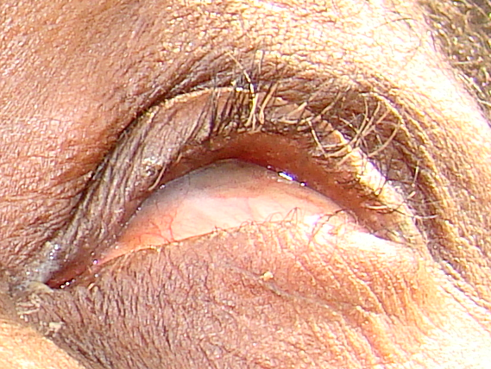
Example 3: Incorrect Suture Tension
Follow-up Photo (one year later)
Notes:
The facilitator presents the FPO photo, asking the participants what they observe and discussing the expectations they named during the previous step.
Sample questions to pose to the group include:
What can one observe about this eye 3-6 months post-operatively?
How do these observations agree with the expectations based on the IPO photo?

Slide 13
Example 3: Incorrect Suture Tension
Both Photos
Notes:
The facilitator presents the IPO and FPO photos side-by-side and asks the participants what, given the FPO photo results, could have been done either during surgery or immediately post-operatively to reduce the chances of a poor outcome.
Sample questions to pose to the group include:
In looking at this photo, what could have been done while the patient was on the table to allow for a better outcome?

Slide 14
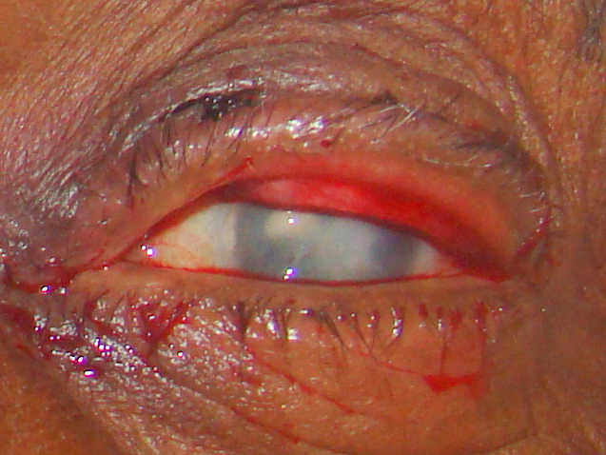
Example 4: Tarsus Exposed
Immediate Postoperative Photo
Notes:
The facilitator asks the participants how they would assess the surgery, highlighting any positives or potential problems while writing responses on flip chart paper.
Sample questions to pose to the group include:
What are the positive surgical aspects of this eyelid?
What potential problems are present in this eyelid?
The facilitator should be prepared to draw the participants’ attention to critical details of the IPO photo if they are not mentioned by participants.
The facilitator asks the participants what, based on the potential problems identified, they would expect to see when the operated case is followed up with 3-6 months later.

Slide 15
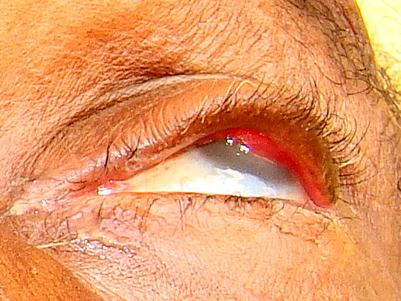
Example 4: Tarsus Exposed
Follow-up Photo (one year later)
Eyelid contour abnormality is visible
Notes:
The facilitator presents the FPO photo, asking the participants what they observe and discussing the expectations they named during the previous step.
Sample questions to pose to the group include:
What can one observe about this eye 3-6 months post-operatively?
How do these observations agree with the expectations based on the IPO photo?

Slide 16
Example 4: Tarsus Exposed
Both Photos
Notes:
The facilitator presents the IPO and FPO photos side-by-side and asks the participants what, given the FPO photo results, could have been done either during surgery or immediately post-operatively to reduce the chances of a poor outcome.
Sample questions to pose to the group include:
In looking at this photo, what could have been done while the patient was on the table to allow for a better outcome?

Slide 17
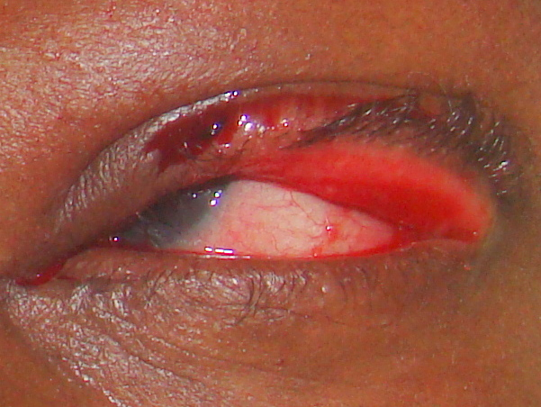
Example 5: Under correction and Overcorrection
Immediate Postoperative Photo
Notes:
The facilitator asks the participants how they would assess the surgery, highlighting any positives or potential problems while writing responses on flip chart paper.
Sample questions to pose to the group include:
What are the positive surgical aspects of this eyelid?
What potential problems are present in this eyelid?
The facilitator should be prepared to draw the participants’ attention to critical details of the IPO photo if they are not mentioned by participants.
The facilitator asks the participants what, based on the potential problems identified, they would expect to see when the operated case is followed up with 3-6 months later.

Slide 18
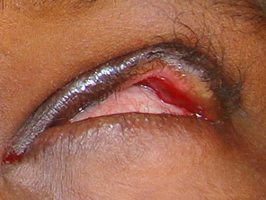
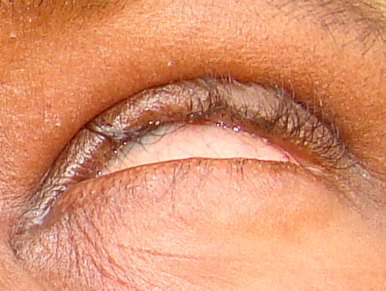
Example 5: Under correction and Overcorrection
Follow-up Photos
6 weeks after excision
1 year after surgery
Notes:
The facilitator presents the FPO photo, asking the participants what they observe and discussing the expectations they named during the previous step.
Sample questions to pose to the group include:
What can one observe about this eye 3-6 months post-operatively?
How do these observations agree with the expectations based on the IPO photo?

Slide 19
Example 5: Under correction and Overcorrection
Both Photos
Notes:
The facilitator presents the IPO and FPO photos side-by-side and asks the participants what, given the FPO photo results, could have been done either during surgery or immediately post-operatively to reduce the chances of a poor outcome.
Sample questions to pose to the group include:
In looking at this photo, what could have been done while the patient was on the table to allow for a better outcome?

Slide 20
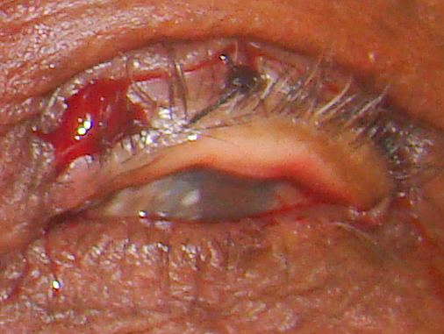
Example 6: Tarsus Exposed
Immediate Postoperative Photo
Notes:
The facilitator asks the participants how they would assess the surgery, highlighting any positives or potential problems while writing responses on flip chart paper.
Sample questions to pose to the group include:
What are the positive surgical aspects of this eyelid?
What potential problems are present in this eyelid?
The facilitator should be prepared to draw the participants’ attention to critical details of the IPO photo if they are not mentioned by participants.
The facilitator asks the participants what, based on the potential problems identified, they would expect to see when the operated case is followed up with 3-6 months later.

Slide 21
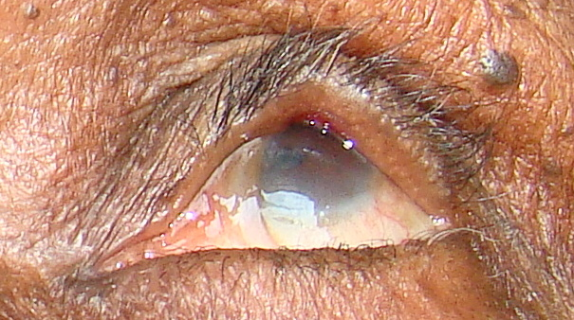
Example 6: Tarsus Exposed
Follow-up Photo
Eyelid contour abnormality is visible
Notes:
The facilitator presents the FPO photo, asking the participants what they observe and discussing the expectations they named during the previous step.
Sample questions to pose to the group include:
What can one observe about this eye 3-6 months post-operatively?
How do these observations agree with the expectations based on the IPO photo?

Slide 22
Example 6: Tarsus Exposed
Both Photos
Notes:
The facilitator presents the IPO and FPO photos side-by-side and asks the participants what, given the FPO photo results, could have been done either during surgery or immediately post-operatively to reduce the chances of a poor outcome.
Sample questions to pose to the group include:
In looking at this photo, what could have been done while the patient was on the table to allow for a better outcome?

Slide 23
Session 2:
Individual Surgeon Review of Photos
Notes:
Describe for participants the sequence of steps that will take place during this session:
The technical supervisor asks each surgeon to review his/her photos and to complete the appropriate form for each eye photographed (either Form 1: Immediate Post-Operative (IPO) Photo Review Form and Form 2: Follow-up Post-Operative (FPO) Photo Review Form).
The technical supervisor sits one-on-one with the individual surgeon and presents the photos from Session 1, referring back to the discussions.
The technical supervisor reviews with each individual surgeon each eyelid for which there is an IPO and FPO photo. As part of the discussion, the technical supervisor reviews each component of the forms that were completed for each eyelid (either Form 1: Immediate Post-Operative (IPO) Photo Review Form or Form 2: Follow-up Post-Operative (FPO) Photo Review Form). The supervisors and surgeon should discuss all questions, including those where their responses differed.

Slide 24
Methodology
  Obtain 1) the photos of your surgeries and 2) the standardized forms to fill out.
  Use a computer to conduct a review of the photos.
  Complete a form for each photo.
  Completely fill out the form for the immediate postoperative photo before reviewing the follow-up photo.
  Wait for a supervisor to come by to discuss your photos.
  After discussing with the supervisor and finalizing the forms, submit the forms to the designated representative.

Slide 25
Session 3:
Collection of Feedback and Group Discussion on Photo Taking
Suggestions and recommendations for the photo taking process

Slide 26
Methodology
  Administration of questionnaire
    Submit the questionnaire to the designated representative
  Discussion
Notes:
Describe for participants the sequence of steps that will take place during this session.
The facilitator administers Form 3: Questionnaire on Photo Taking Utility, Feasibility, and Quality to participants, collecting all forms once participants have completed the exercise.
The facilitator asks the participants if they felt that the photo taking and review of photos were valuable and, if so, why. The facilitator lists the responses on the flip chart.
The facilitator asks the participants what challenges they encountered during the IPO photo taking and lists these on the flip chart.
Addressing the challenges one by one, the facilitator asks the participants to brainstorm how these challenges might be overcome. The facilitator documents relevant points on the flip chart.
The facilitator leads a discussion on whether photo taking should be considered standard operating procedure for surgical camps, documenting relevant points on the flip chart.
If the consensus is to adopt photo taking, the facilitator leads a discussion on how it might be used in addition to the objectives discussed in Session 1: Group Review of Photos.

